Slide 1
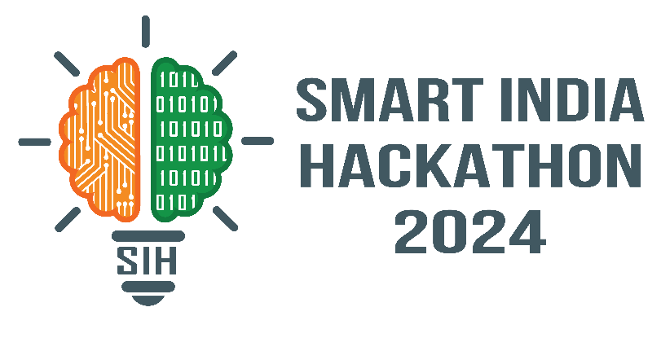

SMART INDIA HACKATHON 2024
TITLE PAGE
Problem Statement ID – 1594
Problem Statement Title- Submit your ideas to address the growing pressures on the city’s resources, transport networks, and logistic infrastructure
Theme- Transportation & Logistics
PS Category- Software
Team Name – Skibidi Codelets

Slide 2
Skibidi
Codelets
Water Leakage Detection Using Meter Gauge Inputs
Detect anomalies or sudden increases in water consumption that could indicate a leak by gathering water meter readings at regular intervals.
The solution addresses a critical need in municipal water management. It enables timely detection and maintenance, reducing water wastage and improving the efficiency of water systems.
The meter generates its own power from the water flow, removing the need for batteries or external power, making it suitable for remote locations.

Slide 3

TECHNNICAL APPROACH
TECHNICAL APPROACH
Installation of Electromagnetic meters for higher accuracy with no moving parts at strategic locations.
Install pressure sensors at various points along the pipeline and set thresholds for acceptable pressure variations based on the expected flow.
IoT based Data logging and connecting the meters and sensors to an IoT platform for real-time monitoring.
Create a maintenance plan to avoid sensor or meter failure.
Provide user-friendly dashboards showing flow rate, pressure, and any anomalies.
Install backup flow meters and sensors for critical sections of the pipeline.
Installation of Electromagnetic meters for higher accuracy with no moving parts at strategic locations.
Install pressure sensors at various points along the pipeline and set thresholds for acceptable pressure variations based on the expected flow.
IoT based Data logging and connecting the meters and sensors to an IoT platform for real-time monitoring.
Set up automatic notifications via SMS, email, or system alerts.
Create a maintenance plan to avoid sensor or meter failure.
Provide user-friendly dashboards showing flow rate, pressure, and any anomalies.
Install backup flow meters and sensors for critical sections of the pipeline.

Slide 4
FEASIBILITY & VIABILITY
TECHNICAL APPROACH
Regular maintenance may be required to ensure the meters remain calibrated and functional over time, adding to the operational costs.
As water conservation becomes more critical, especially in drought-prone areas, the demand for water leak detection systems will increase.
This solution can be viable for both residential and commercial properties. Large-scale operations (e.g., industrial facilities, municipalities)
If the system is automated and provides easy-to-understand data adoption rates are likely to be high
Installation of Electromagnetic meters for higher accuracy with no moving parts at strategic locations.
Install pressure sensors at various points along the pipeline and set thresholds for acceptable pressure variations based on the expected flow.
IoT based Data logging and connecting the meters and sensors to an IoT platform for real-time monitoring.
Set up automatic notifications via SMS, email, or system alerts.
Create a maintenance plan to avoid sensor or meter failure.
Provide user-friendly dashboards showing flow rate, pressure, and any anomalies.
Install backup flow meters and sensors for critical sections of the pipeline.

Slide 5
IMPACT & BENEFITS
TECHNICAL APPROACH
Detecting and fixing leaks helps conserve water, which is crucial in areas facing water scarcity.
Early detection of leaks can prevent damage to infrastructure, extending the lifespan of infrastructure.
By promptly addressing leaks, you ensure that water is used efficiently, which is especially important in regions where water is a limited resource.
Meter gauges can provide valuable data for analyzing water usage patterns and system performance
Installation of Electromagnetic meters for higher accuracy with no moving parts at strategic locations.
Install pressure sensors at various points along the pipeline and set thresholds for acceptable pressure variations based on the expected flow.
IoT based Data logging and connecting the meters and sensors to an IoT platform for real-time monitoring.
Set up automatic notifications via SMS, email, or system alerts.
Create a maintenance plan to avoid sensor or meter failure.
Provide user-friendly dashboards showing flow rate, pressure, and any anomalies.
Install backup flow meters and sensors for critical sections of the pipeline.

Slide 6
Skibidi
Codelets
Optimizing Public Transport
Leveraging big data and the Internet of Things (IoT) allows for effective route planning, real-time operational adjustments, and predictive maintenance. For eg.Analyzing ticketing data to understand passenger flows and make service adjustments
Enabling demand-responsive transport based on real-time conditions
Using IoT sensors to monitor vehicle health or collect environmental data

Slide 7
TECHNNICAL APPROACH
TECHNICAL APPROACH
Gather data on passenger flows, traffic patterns, and vehicle performance and apply advanced analytics to identify trends, optimize schedules, and improve service delivery.
Model traffic flow to assess the impact of different transport strategies.
IoT based Data logging and connecting the meters and sensors to an IoT platform for real-time monitoring.
Implement algorithms to create optimal schedules that minimize wait times and maximize resource utilization.
Implement intelligent traffic signal systems to improve flow and reduce congestion.
Installation of Electromagnetic meters for higher accuracy with no moving parts at strategic locations.
Install pressure sensors at various points along the pipeline and set thresholds for acceptable pressure variations based on the expected flow.
IoT based Data logging and connecting the meters and sensors to an IoT platform for real-time monitoring.
Set up automatic notifications via SMS, email, or system alerts.
Create a maintenance plan to avoid sensor or meter failure.
Provide user-friendly dashboards showing flow rate, pressure, and any anomalies.
Install backup flow meters and sensors for critical sections of the pipeline.

Slide 8
FEASIBILITY & VIABILITY
TECHNICAL APPROACH
Using GPS and IoT for real-time updates and route adjustments.
Ensure compatibility with existing transport systems and facilities.
Evaluate long-term financial returns from increased efficiency and user satisfaction
Analyze the environmental impact, such as reduced emissions from more efficient transport or the use of green technologies.
Installation of Electromagnetic meters for higher accuracy with no moving parts at strategic locations.
Install pressure sensors at various points along the pipeline and set thresholds for acceptable pressure variations based on the expected flow.
IoT based Data logging and connecting the meters and sensors to an IoT platform for real-time monitoring.
Set up automatic notifications via SMS, email, or system alerts.
Create a maintenance plan to avoid sensor or meter failure.
Provide user-friendly dashboards showing flow rate, pressure, and any anomalies.
Install backup flow meters and sensors for critical sections of the pipeline.

Slide 9
IMPACT & BENEFITS
TECHNICAL APPROACH
Efficient public transport systems can decrease the number of vehicles on the road, leading to lower greenhouse gas emissions and improved air quality.
Individuals save money on fuel, maintenance, and parking.
Improved public transport enhances mobility for people who do not own a car, including the elderly, disabled, and low-income individuals..
Better public transport can reduce traffic congestion.
Areas well-served by public transport often see increased property values and economic development.
Installation of Electromagnetic meters for higher accuracy with no moving parts at strategic locations.
Install pressure sensors at various points along the pipeline and set thresholds for acceptable pressure variations based on the expected flow.
IoT based Data logging and connecting the meters and sensors to an IoT platform for real-time monitoring.
Set up automatic notifications via SMS, email, or system alerts.
Create a maintenance plan to avoid sensor or meter failure.
Provide user-friendly dashboards showing flow rate, pressure, and any anomalies.
Install backup flow meters and sensors for critical sections of the pipeline.

Slide 10
RESEARCH AND REFERENCES
Skibidi Codelets
International Water Association (IWA): They focus on water efficiency and technology.
Scientific journals and industry reports: For detailed studies and specific examples.
Case Studies and Real-World Examples:
Cities like Copenhagen, New York, and Singapore: Known for their effective public transport systems and their documented benefits.

